Slide 1
WiFi hacking and Packet Sniffing
BootCon project 2022
Hannad Afzal, Malka Hakuk, and Olasunkanmi Adeniyi

Slide 2
Overview
In this demonstration you will learn the necessary tools, commands and good tricks to hack any wifi password together with packet sniffing.

Slide 3
Goal
The goal of this demonstration is to crack any wifi password and with this information listen to the network traffic and sniff the packets.
We chose this topic because we were curious to know how vulnerable our networks are, and how to mitigate these risks.

Slide 4
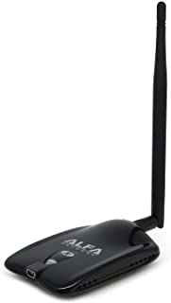
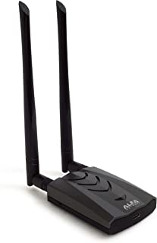
Devices and Technologies required:
WiFi network adapter (best external) that supports 802.11n traffic and monitor mode.
Linux Operating System
Airmon-ng, Aircrack-ng and Wireshark.
Alfa 2.4Ghz
Alfa 2.4/5Ghz
WiFi network adapter recommended

Slide 5
Monitor Mode and 802.11n
Monitor mode, allows a computer with a wireless network interface controller (WNIC) to monitor all traffic received on a wireless channel.
It allows packets to be captured without having to associate with an access point or ad hoc network first.
Monitor mode only applies to wireless networks and is one of the eight modes that 802.11 wireless adapter can operate in: Master, Managed, Ad hoc, Repeater, Mesh, Wi-Fi Direct, TDLS and Monitor mode.

Slide 6
Attack demonstration
Step by step

Slide 7
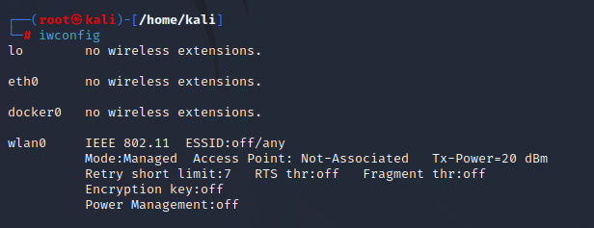
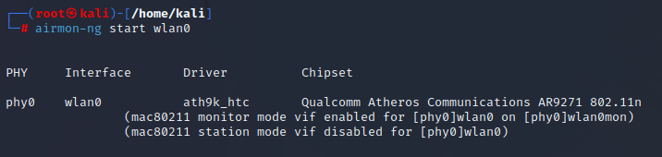
Check for available broadcasts
Setting wlan0 to Monitor mode
Notes:
Wlan0 is you

Slide 8
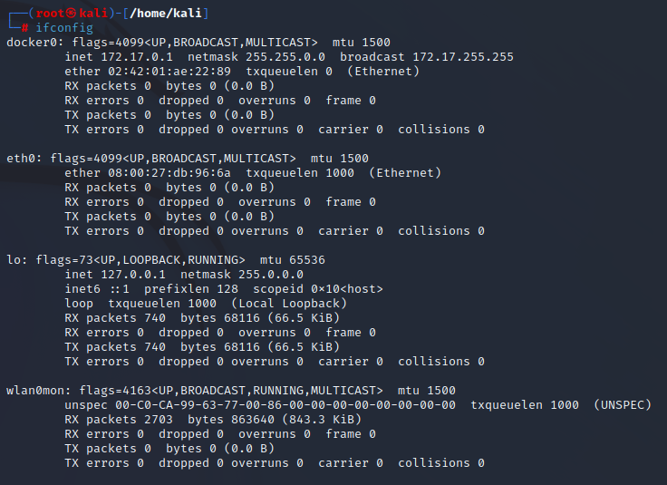
Wlan0mon - monitor mode

Slide 9
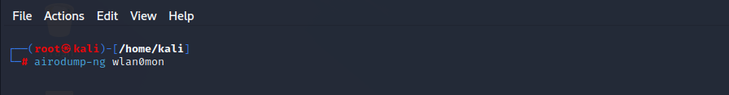
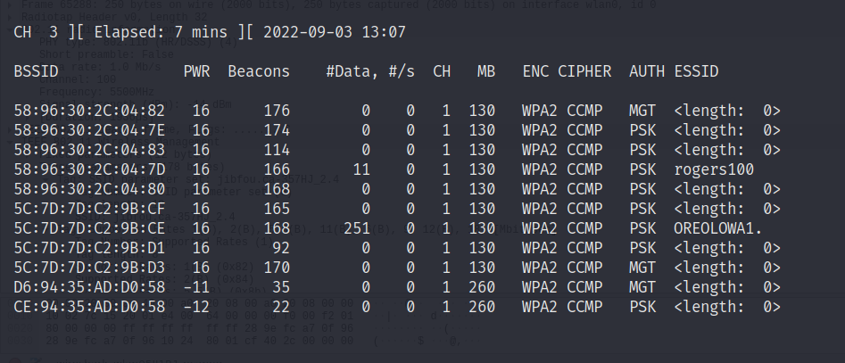
Network Scanning
The command for network scanning will be
airodump-ng wlan0mon

Slide 10
The EAPOL Handshake
Extensible Authentication Protocol (EAP) over LAN (EAPoL Protocol) is a network port authentication protocol used in IEEE 802.1X (Port Based Network Access Control) developed to give a generic network sign-on to access network resources.
EAPOL is the method used by WPA2 to exchange identities in both WPA2/PSK and WPA2/802.1x (Enterprise) modes and to install the keys to establish an encrypted connection. Within WPA2, if a response is not received by a station (client) it can request a resend.

Slide 11
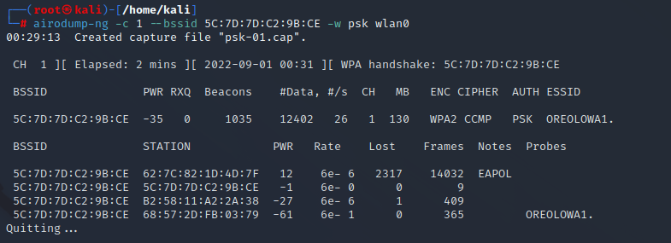
Listen to a selected channel
Listen to a selected channel and wait for a EAPOL handshake (WPA handshake as the image above)

Slide 12
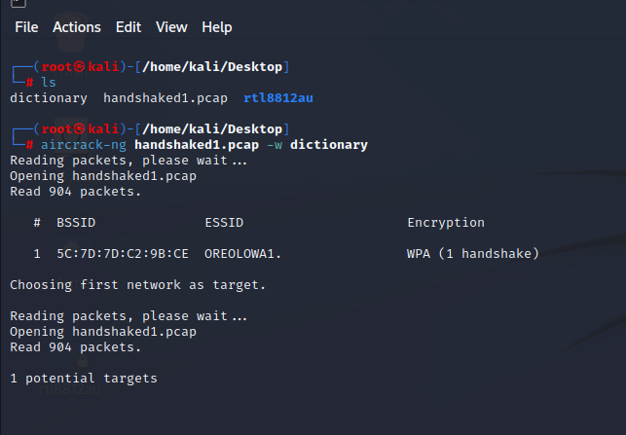
Aircrack handshake

Slide 13
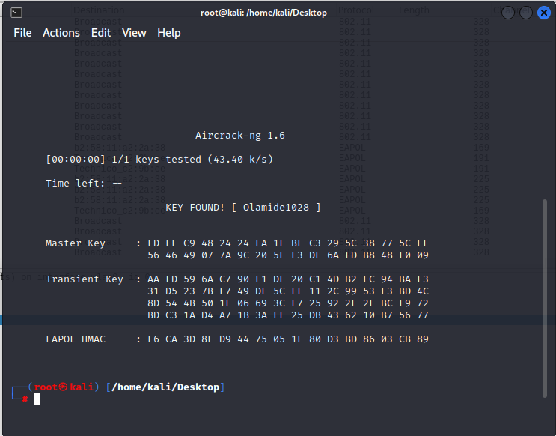
Bruteforce WiFi Password using wordlist

Slide 14
Packet sniffing

Slide 15
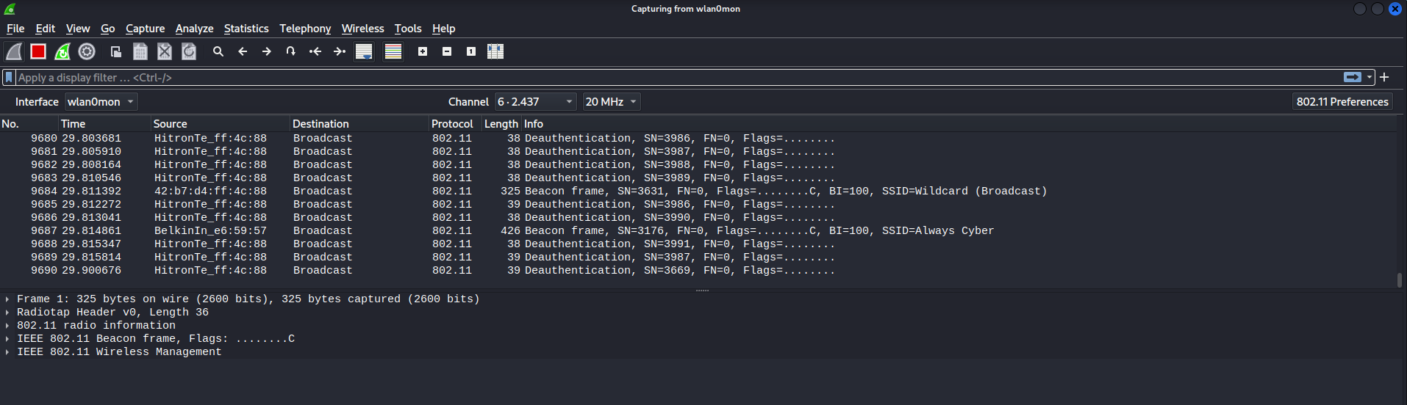
Set Capture Channel on Wireshark

Slide 16
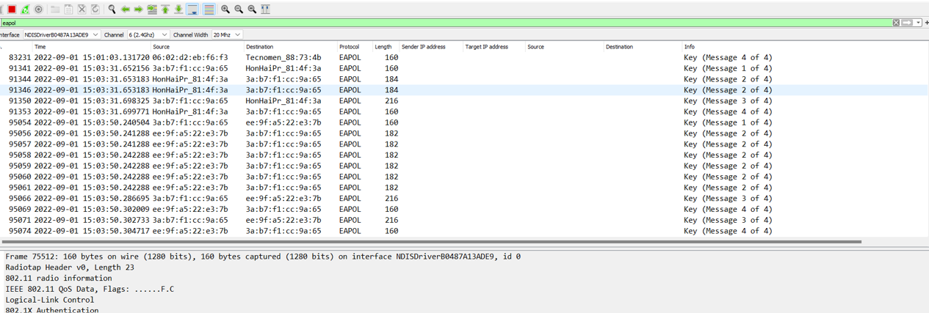
Eapol Handshake
Wireshark needs to see the key exchange during the Eapol handshake between a device on your network and the access point.

Slide 17
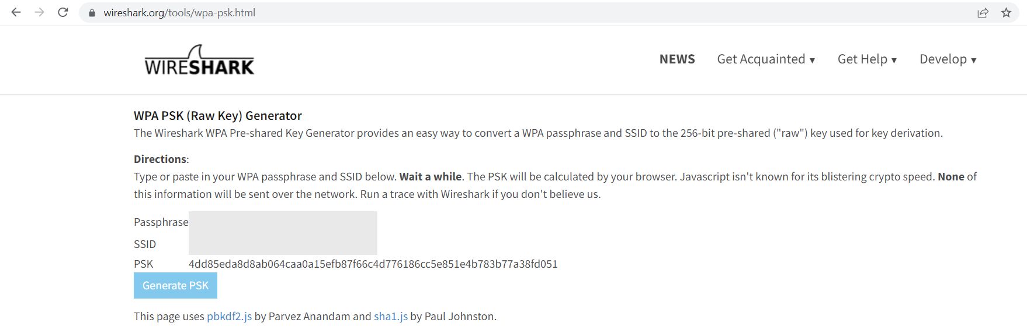
Generate WPA-PSK key
Once the wifi passphrase is found, the WPA-PSK key that will be configured on wireshark can be found on aircrack-ng or simply converting on this website (https://www.wireshark.org/tools/wpa-psk.html) so the traffic can be decrypted.

Slide 18
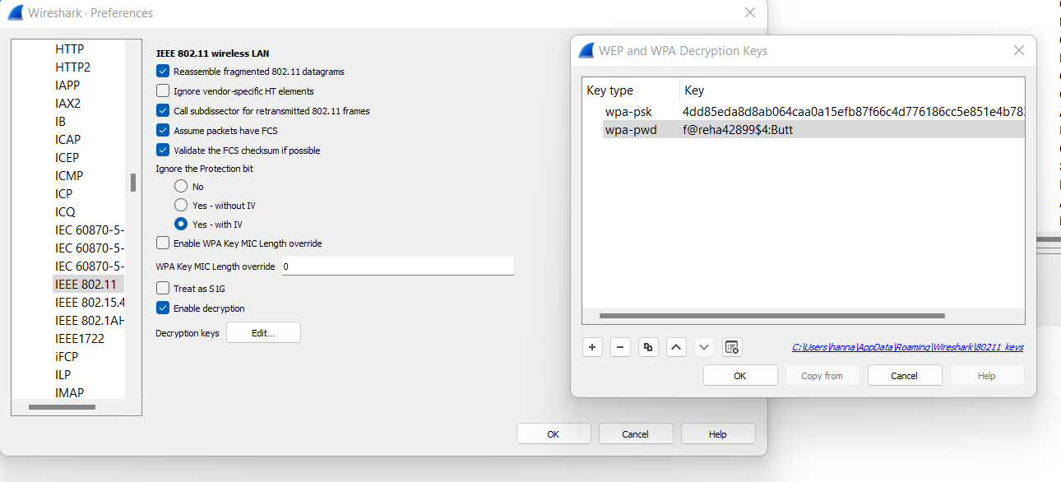
Setting WPA-PSK and PWD description keys

Slide 19
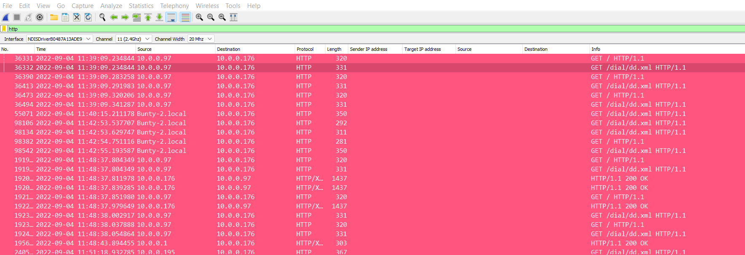
Decrypted HTTP Packets

Slide 20
Mitigation
How can wireless networks and packet sniffing can be protected against compromise?
Create a strong password.
Accessing HTTPS webpages only to avoid packet sniffing.
Use a virtual private network (VPN) especially when remotely accessing assets.

Slide 21
Thank you!

